Slide 1

Python Essentials
Introduction to Python Essentials

Slide 2
Introduction to Python Essentials
In this Tutorial we are going to Cover –
Introduction
Python Basics
Python Flow Control
Python Functions
Python Datatypes
Python File Handling and Exception
Python Class and Objects
Python Miscellaneous
Etc.
Notes:
Functional programming supports partially applied functions, currying, support for first class functions and closures.

Slide 3
Python Essentials
Overview of Python

Slide 4
Python Essentials
Getting Started with Anaconda

Slide 5
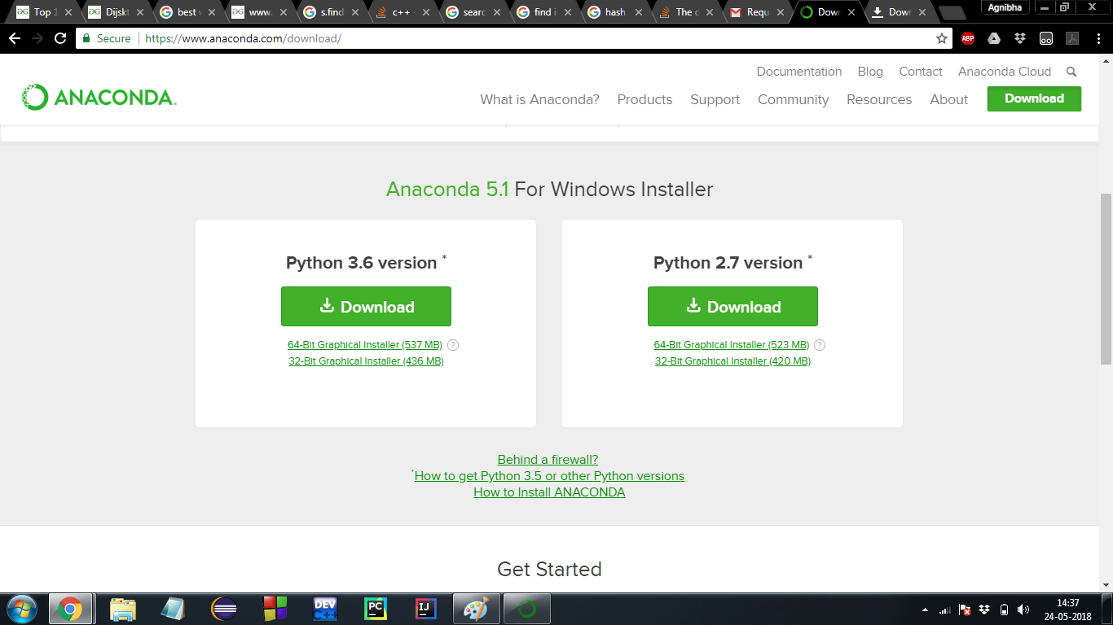
Getting Started with Anaconda
Anaconda download link –
https://www.anaconda.com/download/

Slide 6
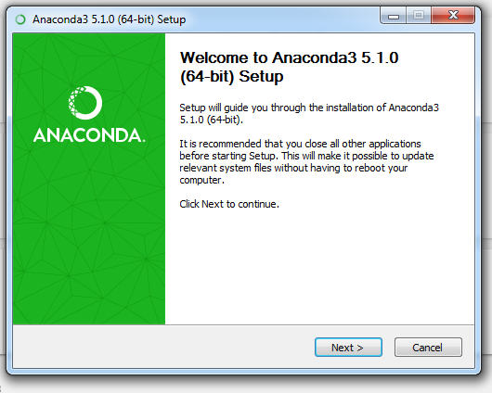
Getting Started with Anaconda

Slide 7
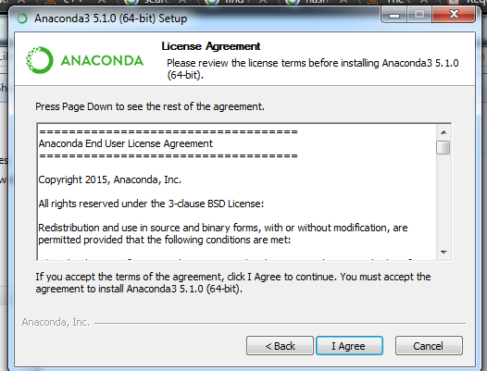
Getting Started with Anaconda

Slide 8
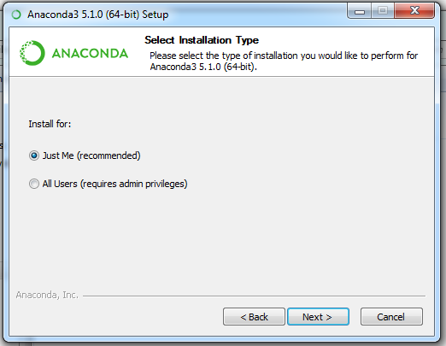
Getting Started with Anaconda

Slide 9
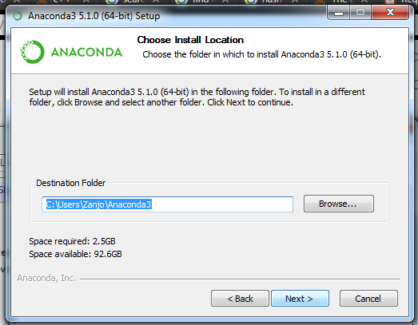
Getting Started with Anaconda

Slide 10
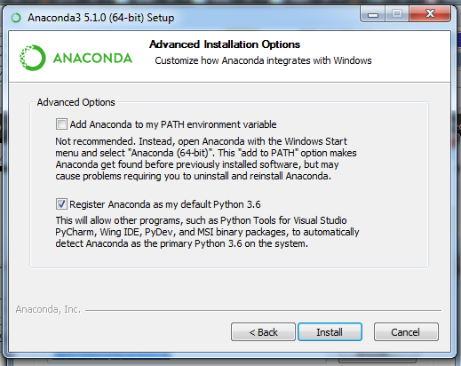
Getting Started with Anaconda

Slide 11
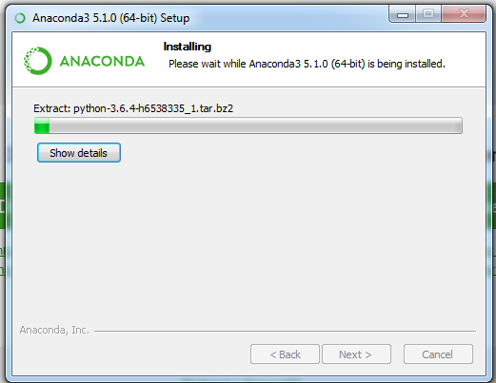
Getting Started with Anaconda

Slide 12
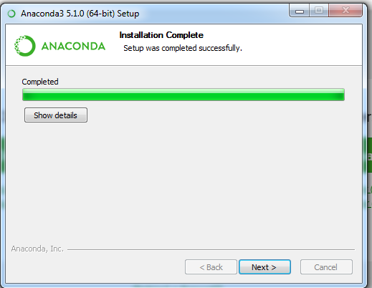
Getting Started with Anaconda

Slide 13
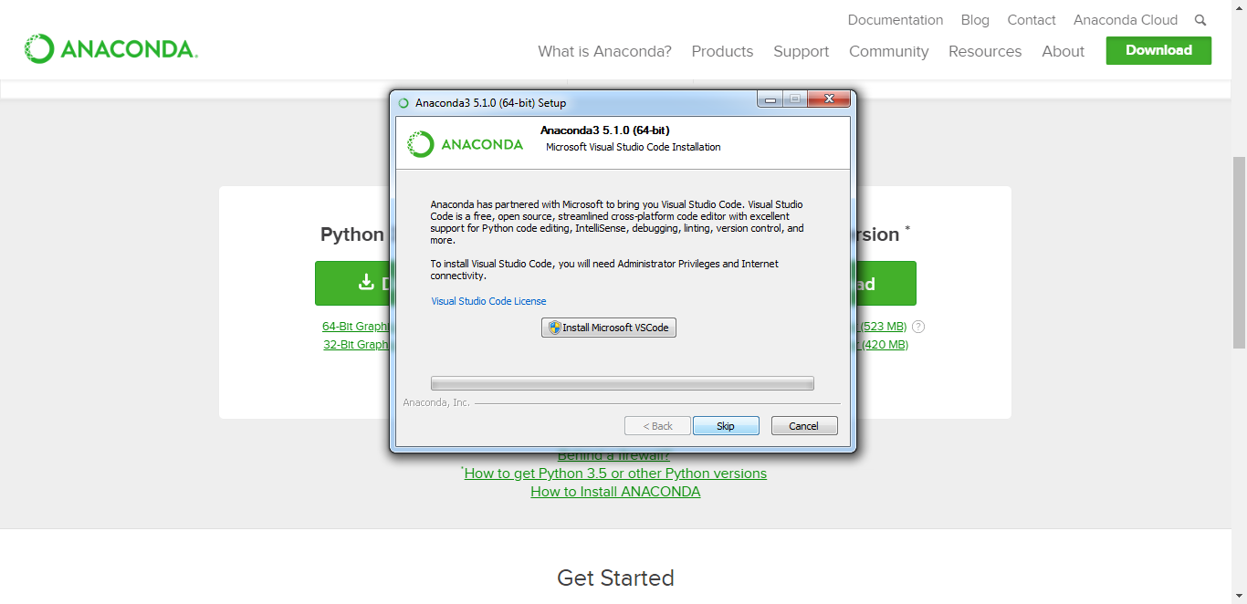
Getting Started with Anaconda

Slide 14
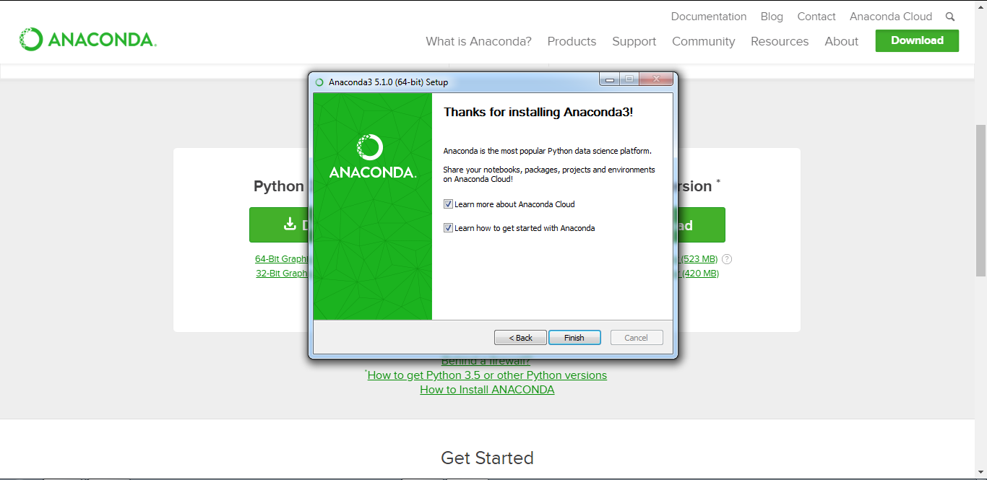
Getting Started with Anaconda

Slide 15
Python Essentials
Python Keywords & Identifiers

Slide 16
Python Keywords and Identifiers
Python Keywords –
Keywords are the reserved words in Python.
During coding keywords can’t be used as variable name, function name or any other identifier. They are used to define the syntax and structure of the Python language.
Keywords are case sensitive in Python.

Slide 17
Python Keywords and Identifiers
List of Python Keywords –
False | class | finally | is | return
None | continue | for | lambda | try
True | def | from | nonlocal | while
and | del | global | not | with
as | elif | if | or | yield
assert | else | import | pass
break | except | in | raise

Slide 18
Python Keywords and Identifiers
Python Identifier – Identifier is nothing but the names given to entities like class, functions, variables etc. in Python. It helps us in differentiating one entity from another.
Rules for writing identifiers:
Identifiers can be a combination of letters in lowercase (a to z) or uppercase (A to Z) or digits (0 to 9) or an underscore (_). Names like myClass1, var_2 and display_to_screen, all are valid example.
An identifier cannot start with a digit. 1variable is invalid, but variable1 is perfectly fine.
Keywords cannot be used as identifiers.
We cannot use special symbols like !, @, #, $, % etc. in our identifier.
Let us go for a demonstration…

Slide 19
Python Essentials
Python Statements & Comments

Slide 20
Python Statements and Comments
Python Statement - Instructions that a Python interpreter can execute are called statements. For example, kount = 10 is an assignment statement. if statement, for statement, while statement etc.
Multi-line statement - In Python, end of a statement is marked by a newline character. But we can make a statement extend over multiple lines with the line continuation character (\). For example:
print(‘Welcome to \
the world \
of programming”)

Slide 21
Python Statements and Comments
Python Indentation – Like other programming languages e.g. C, C++, Java use braces { } to define a block of code. Python uses indentation.
As example:
for i in range(1,10):
for j in range(1,5):
print(i,j)

Slide 22
Python Statements and Comments
Python Comments
In Python, we use the hash (#) symbol to start writing a line comment.
As example:
# this is a line comment

Slide 23
Python Statements and Comments
Multi-line comments –
If we have comments that extend multiple lines, one way of doing it is to use hash (#) in the beginning of each line. For example:
# In this program, we have
# used functions and
# iterations
Another way of doing this is to use triple quotes, either ''' or """.
These triple quotes are generally used for multi-line strings. But they can be used as multi-line comment as well. Unless they are not docstrings, they do not generate any extra code. As example:
'''This is a
multiline comment'''

Slide 24
Python Statements and Comments
Docstring in Python –
Docstring is short for documentation string.
It is a string that occurs as the first statement in a module, function, class, or method definition. We must write what a function/class does in the docstring.
Let us go for a demonstration…

Slide 25
Python Essentials
Python Variables and Constants

Slide 26
Python Variables
In Python variable is a named location used to store data in the memory. Each variable must have a unique name called identifier.
In Python, variables do not need declaration to reserve memory space. The "variable declaration" or "variable initialization" happens automatically when we assign a value to a variable.
As example:
kount = 100
emp_name = "Robin“
age1, age2, age3 = 44, 37, 22

Slide 27
Python Constants
A constant is a type of variable whose value cannot be changed. It is helpful to think of constants as containers that hold information which cannot be changed later.
Naming conventions for variables and constants in Python:
Nomenclature should be purpose
Use camelCase notation
Use capital letters to represent a constant
Symbols like @, #, !, $ % etc. should not be used
Don’t start with a digit
Constants are put into Python modules and meant not be changed.
Constant and variable names should have combination of letters in lowercase (a to z) or uppercase (A to Z) or digits (0 to 9) or an underscore (_).
Let us go for a demonstration…

Slide 28
Python Essentials
Python Different Datatypes

Slide 29
Python Different Datatypes
Each value in Python has got a datatype. Following is the list of some important datatypes:
Python Numbers
Python List
Python Tuple
Python Strings
Python Set
Python Dictionary
Also in Python conversion between datatypes are possible.

Slide 30
Python Essentials
Python Datatype Conversion and Type Casting

Slide 31
Python Datatype Conversion & Type Casting
Datatype Conversion in Python:
The process of converting the value of one data type (integer, string, float, etc.) to another data type is called type conversion. Python has two types of type conversion.
Implicit Type Conversion
Explicit Type Conversion
Let us go for the demonstration…

Slide 32
Python Essentials
Python Input, Output and Import

Slide 33
Python Input, Output and Import
Some of the functions like input() and print() are widely used for standard input and output operations respectively.
When our program grows bigger, it is a good idea to break it into different modules.
For the ease of program development, definitions inside a module can be imported to another module or the interactive interpreter in Python. We use the import keyword to do this.
Let us go for the demonstration…

Slide 34
Python Essentials
Python Operators

Slide 35
Python Operators
Operators are special symbols in Python that carry out arithmetic or logical computation. The value that the operator operates on is called the operand.
In Python operators can be classified as below:
Arithmetic operators
Comparison operators
Logical operators
Bitwise operators
Assignment operators
Special operators
Identity operators
Membership operators

Slide 36
Python Operators
Arithmetic Operators in Python:
Operator | Meaning | Example
+ | Add two operands or unary plus | x + y, +2
- | Subtract right operand from the left or unary minus | x – y, -2
* | Multiply two operands | x * y
/ | Divide left operand by the right one (always results into float) | x / y
% | Modulus - remainder of the division of left operand by the right | x % y (remainder of x/y)
// | Floor division - division that results into whole number adjusted to the left in the number line | x // y
** | Exponent - left operand raised to the power of right | x**y (x to the power y)

Slide 37
Python Operators
Comparison Operators in Python:
Operator | Meaning | Example
> | Greater that - True if left operand is greater than the right | x > y
< | Less that - True if left operand is less than the right | x < y
== | Equal to - True if both operands are equal | x == y
!= | Not equal to - True if operands are not equal | x != y
>= | Greater than or equal to - True if left operand is greater than or equal to the right | x >= y
<= | Less than or equal to - True if left operand is less than or equal to the right | x <= y

Slide 38
Python Operators
Logical Operators in Python:
Operator | Meaning | Example
and | True if both the operands are true | x and y
or | True if either of the operands is true | x or y
not | True if operand is false (complements the operand) | not x

Slide 39
Python Operators
Bitwise Operators in Python:
Operator | Meaning | Example
& | Bitwise AND | x & y
| | Bitwise OR | x | y
~ | Bitwise NOT | ~x
^ | Bitwise XOR | x ^ y
>> | Bitwise right shift | x >> 2
<< | Bitwise left shift | x << 2

Slide 40
Python Operators
Assignment Operators in Python
Operator | Example | Equivatent to
= | x = 2 | x = 2
+= | x += 2 | x = x + 2
-= | x -= 2 | x = x – 2
*= | x *= 2 | x = x * 2
/= | x /= 2 | x = x / 2
%= | x %= 2 | x = x % 2
//= | x //= 2 | x = x // 2
**= | x **= 2 | x = x ** 2
&= | x &= 2 | x = x & 2
|= | x |= 2 | x = x | 2
^= | x ^= 2 | x = x ^ 2
>>= | x >>= 2 | x = x >> 2
<<= | x <<= 2 | x = x << 2

Slide 41
Python Operators
Special Operators: Identify Operators in Python
Operator | Meaning | Example
is | True if the operands are identical (refer to the same object) | x is True
is not | True if the operands are not identical (do not refer to the same object) | x is not True

Slide 42
Python Operators
Special Operators: Membership Operators in Python
Operator | Meaning | Example
in | True if value/variable is found in the sequence | 2 in x
not in | True if value/variable is not found in the sequence | 2 not in x
Let us go for the demonstration…

